Slide 1
Welcome to HOTT
Health Occupations for Today and Tomorrow

Slide 2
Have you given much thought to what you want to do when you finish high school?

Slide 3
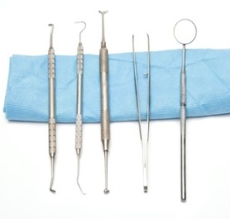
Little kids often say, “When I grow up, I want to be a _________”
Fireman
Policeman
Teacher
Pro Athlete
Doctor
Nurse

Slide 4
But you’re not a kid any more. It’s time to discuss some options for the future.

Slide 5
How do I get there? (And where is “there” for me?)
Do I need to go to college?
Which college offers what I need?
How long will I have to go to school?
How will I pay for my education?
Will it be easy to find a job?
How much will I get paid?
What will I be doing each day as a _______?

Slide 6
What about medicine or nursing?

Slide 7
Want to become a doctor?
Very rewarding and honorable career
Lengthy and challenging education and training (4 years college, 4 years medical school, and 3 or more years of residency)
Selective process: in previous years, about 1 out of 7 applicants got accepted into the Sanford School of Medicine at the University of South Dakota (*Capital Journal)
Roughly 50% of medical students in SD are women
Lifetime learning and maintenance of licensure and certification is expected

Slide 8
Want to be a nurse?
With a nationwide shortage of nurses, many hospitals have openings and offer educational assistance/hiring bonuses
More men are becoming nurses
Two major paths to becoming an RN: associate’s degree or bachelor’s degree
Advanced opportunities include nurse practitioner, clinical nurse specialist, nurse anesthetist, and nurse midwife

Slide 9
So what other choices do I have for careers in the health care field?

Slide 10
Some of these health professions may be familiar to you…
Laboratory Technician
Radiological Technologist
Physical Therapist
Physician Assistant
Dental Hygienist
Dietitian

Slide 11
…And some may not
Art Therapist
Nuclear Medicine Technologist
Diagnostic Medical Sonographer
Health Educator
Epidemiologist
Phlebotomist
Respiratory Therapist

Slide 12
How do I choose which career is right for me?
Consider length of education, salary, job duties, current/future staffing needs
And think about your interests and your personality type. For example…

Slide 13
Are you a “doer”?
Athletic Trainer
Certified Nursing Assistant
Dental Laboratory Technician
Orthotist/Prosthetist

Slide 14
Athletic Trainer
What They Do: Evaluate
And advise individuals to
assist recovery from or
avoid athletic-related
injuries or illnesses, or
maintain peak physical
fitness. May provide first aid or emergency care.
Education: at least a bachelor’s degree in athletic training or a related program.
Median salary in SD: $40,600

Slide 15
Certified Nursing Assistant
What They Do: Provide basic patient care under direction of nursing
staff. Perform duties
such as feed, bathe,
dress, groom, or move
patients, or change
linens. May transfer or
transport patients.
Includes nursing care attendants, nursing aides, and nursing attendants.
Education: complete occupational training and certification.
Median Salary in SD: $22,600

Slide 16
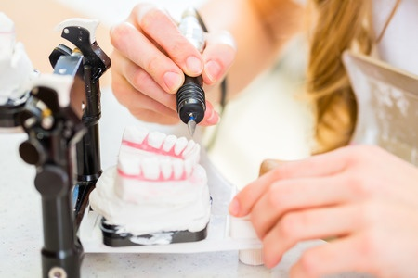
Dental Laboratory Technician
What They Do: Construct and repair full or partial dentures or dental appliances such as crowns and bridges.
Education: at least a high school diploma.
Median Salary in SD: $30,600

Slide 17
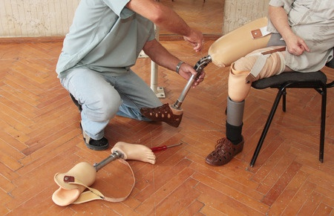
Orthotist/Prosthetist
What They Do: Design, measure, fit, and adapt orthopedic braces, appliances or prostheses, such as limbs or facial parts for patients with disabling conditions.
Education: A master’s degree in orthotics or prosthetics.
Median Salary in SD: $59,100

Slide 18
Are you an active person?
Chiropractor
Massage Therapist
Occupational Therapist
Occupational Therapy Assistant
Physical Therapist
Physical Therapist Assistant

Slide 19
Chiropractor
What They Do: Assess, treat, and care for patients by manipulation of spine and musculoskeletal system. May provide spinal adjustment or address sacral or pelvic misalignment.
Education: a doctoral or professional degree in chiropractic studies.
Median Salary in SD: $66,700

Slide 20
Massage Therapist
What They Do: Perform therapeutic massages of soft tissues and joints. May assist in the assessment of range of motion and muscle strength, or propose client therapy plans.
Education: vocational training and post- secondary certificate.
Median Salary in SD:
$31,000

Slide 21
Occupational Therapist
What They Do: Assess, plan, organize, and participate in rehabilitative programs that help build or restore vocational, homemaking, and daily living skills, as well as general independence, to persons with disabilities or developmental delays.
Education: at least a master’s degree in occupational therapy.
Median Salary in SD: $61,800

Slide 22
Occupational Therapy Assistant
What They Do: Assist occupational therapists in providing occupational therapy treatments and procedures. May, in accordance with State laws, assist in development of treatment plans, carry out routine functions, direct activity programs, and document the progress of treatments.
Education: an associate’s degree in occupational therapy assistant studies or related program.
Median Salary in U.S: $ 57,260 (*National data not SD)

Slide 23
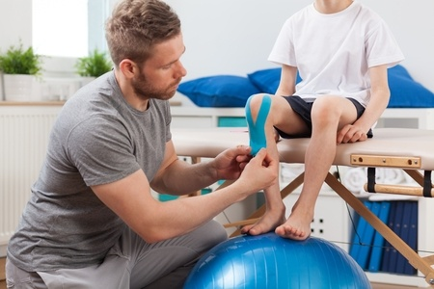
Physical Therapist
What They Do: Assess, plan, organize, and participate in rehabilitative programs that improve mobility, relieve pain, increase strength, and improve or correct disabling conditions resulting from disease or injury.
Education: a doctoral
degree in physical
therapy.
Median Salary in SD:
$71,200

Slide 24
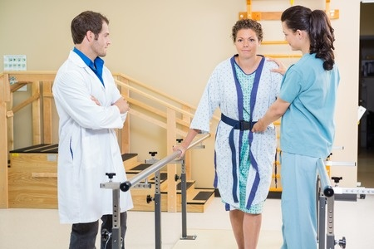
Physical Therapist Assistant
What They Do: Assist physical therapists in providing physical therapy treatments and procedures. May, in accordance with State laws, assist in the development of treatment plans, carry out routine functions, document the progress of treatment, and modify specific treatments in accordance with patient status and within the scope of treatment plans established by a physical therapist.
Education: at least an associate’s degree from a physical therapy assistant program.
Median Salary in SD: $34,700

Slide 25
Are you an analyst?
Cardiovascular Technologist
Diagnostic Medical Sonographer
Medical Laboratory Technician
Pharmacy Technician

Slide 26
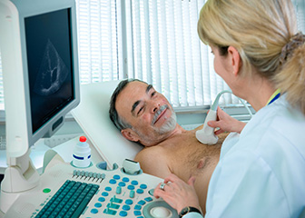
Cardiovascular Technologist
What They Do: Conduct tests on pulmonary or cardiovascular systems of patients for diagnostic purposes. May
conduct or assist in
electrocardiograms,
cardiac catheterizations,
pulmonary functions, lung
capacity, and similar tests.
Education: at least an associate’s degree in cardiovascular technology or a related program.
Median Salary in SD: $45,400

Slide 27
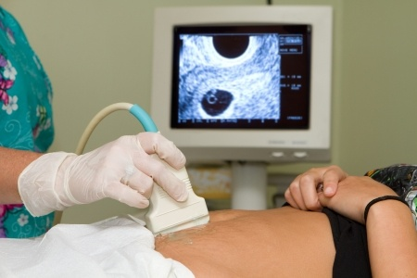
Diagnostic Medical Sonographer
What They Do: Produce
ultrasonic recordings of
internal organs for use
by physicians.
Education: at least
an associate’s degree in medical sonography or a related program.
Median Salary in SD: $55,400

Slide 28
Medical Laboratory Technician
What They Do: Perform routine medical laboratory tests for the diagnosis, treatment, and prevention of disease. May work under the supervision of a medical technologist.
Education: an associate’s degree in medical technology or related program.
Median Salary in SD: $34,600

Slide 29
Pharmacy Technician
What They Do: Prepare medications under the direction of a pharmacist. May measure, mix, count out, label, and record amounts and dosages of medications according to prescription orders.
Education: complete vocational training or complete a pharmacy technology program.
Median Salary in SD: $28,800

Slide 30
Are you a “people person”?
Counselor
Home Health Aide
Medical Assistant
Recreational Therapist
Rehabilitation Counselor

Slide 31
Counselor
What They Do: Counsel with emphasis on prevention. Work with individuals and groups to promote optimum mental and emotional health. May help individuals deal with issues associated with addictions and substance abuse; family, parenting, and marital problems; stress management; self-esteem; and aging.
Education: a master’s
degree in counseling
or related program.
Median Salary in SD:
$41,900

Slide 32
Home Health Aide
What They Do: Provide routine individualized healthcare such as changing bandages and dressing wounds, and applying topical medications to the elderly, convalescents, or persons with disabilities at the patient's home or in a care facility. Monitor or report changes in health status. May also provide personal care such as bathing, dressing, and grooming of patient.
Education: complete occupational training.
Median Salary in SD: $25,400

Slide 33
Medical Assistant
What They Do: Perform administrative and certain clinical duties under the direction of a physician. Administrative duties may include scheduling appointments, maintaining medical records, billing, and coding information for insurance purposes. Clinical duties may include taking and recording vital signs and medical histories, preparing patients for examination, drawing blood, and administering medications as directed by physician.
Education: an associate’s degree in medical assisting or vocational training.
Median Salary in SD: $27,600

Slide 34
Recreational Therapist
What They Do: Plan, direct, or coordinate medically-approved recreation programs for patients in hospitals, nursing homes, or
other institutions. Activities
include sports, trips,
dramatics, social activities,
and arts and crafts. May
assess a patient condition
and recommend appropriate recreational activity.
Education: a bachelor’s degree in recreational therapy or related program.
Median Salary in SD: $35,900

Slide 35
Rehabilitation Counselor
What They Do: Counsel individuals to maximize the independence and employability of persons coping with personal, social, and vocational difficulties that result from birth defects, illness, disease, accidents, or the stress of daily life. Coordinate activities for residents of care and treatment facilities.
Education: at least a bachelor’s degree in guidance counseling or psychology.
Median Salary in SD:$36,000

Slide 36
Are you into computers and technology?
Biomedical Technician
Medical Records and Health Information Technician
Medical Transcriptionist

Slide 37
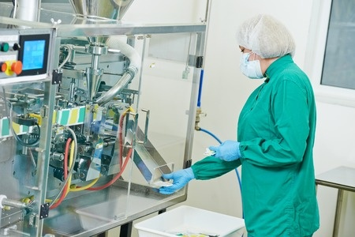
Biomedical Technician
What They Do: Test, adjust, or repair biomedical or electro-medical equipment.
Education: an associate’s degree in biomedical equipment technology, electronics, or related program.
Median Salary in SD: $48,900

Slide 38
Medical Records and Health Information Technician
What They Do: Compile, process, and maintain medical records of hospital and clinic patients in a manner consistent with medical, administrative, ethical, legal, and regulatory requirements of the health care system. Process, maintain, compile, and report patient information for health requirements and standards in a manner consistent with the healthcare industry's numerical coding system.
Education: an associate’s degree in medical records technology, medical transcription, or related program.
Median Salary in SD: $33,600

Slide 39
Medical Transcriptionist
What They Do: Transcribe medical reports recorded by physicians and other healthcare practitioners using various electronic devices, covering office visits, emergency room visits, diagnostic imaging studies, operations, chart reviews, and final summaries. Transcribe dictated reports and translate abbreviations into fully understandable form. Edit as necessary and return reports in either printed or electronic form for review and signature, or correction.
Education: complete a
medical transcription
training program.
Median Salary in SD:
$29,900

Slide 40
These are just a few examples of health careers
Acupuncturist
Audiologist
Biomechanist
Biomedical Engineer
Child Life Specialist
Clinical Psychologist
Dental Assistant
Dialysis Technician
Dietetic Technician
Electroneurodiagnostic Technologist
Environmental Health Specialist
Exercise Scientist
Genetic Counselor
Healthcare Social Worker
Microbiologist
Nurse Anesthetist
Nurse Practitioner
Opthalmic Laboratory Technician
Optometrist
Paramedic/EMT
Perfusionist
Podiatrist
Speech Language Pathologist
Surgical Technologist

Slide 41
The list goes on and on!

Slide 42
So the next time you think about what you want to do after high school…

Slide 43
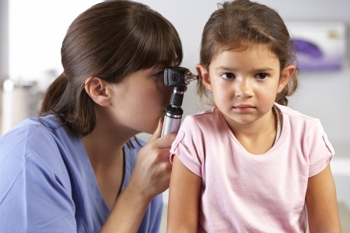
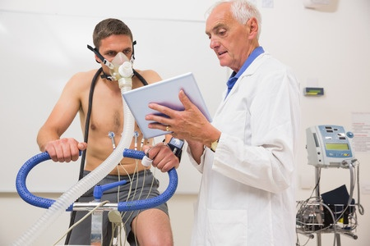
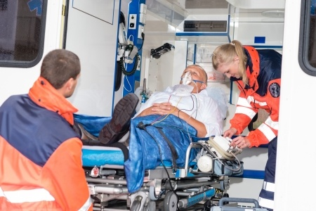
Consider a career in the health field!

Slide 44
Resources
South Dakota Career InSite www.sdjobs.org/careerinsite
South Dakota Occupational Profiles
www.sdjobs.org/lmic/occprofiles
Career OneStop www.careeronestop.org
O*Net Online online.onetcenter.org
Updated November 2015.

